Slide 1
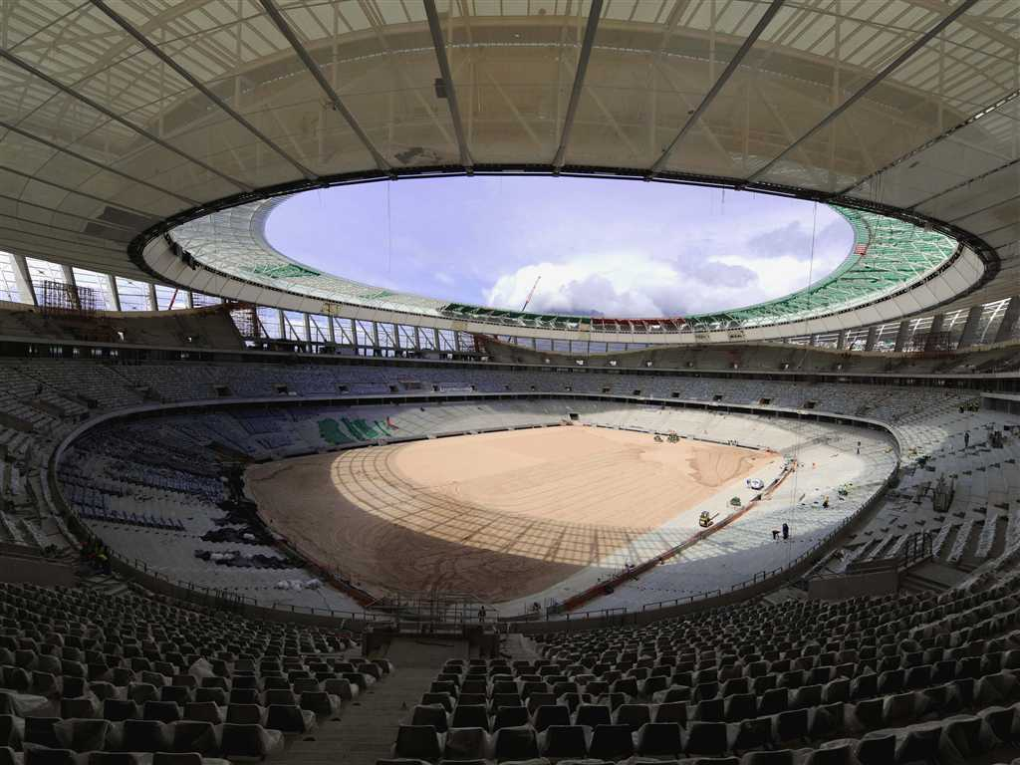
VISÃO GERAL
Estruturas Condicionais
Slide Show

Slide 2
<html >
<head><title>Galeria de fotos em Javascript</title></head>
<body >
<table width="672" align="center">
<tr>
<td colspan="5" align="center">
<img src="01.jpg" name="galeria" width="700" height="523" id="galeria" />
</td></tr>
<tr>
<td width="146"><img src="01.jpg" width="100" height="90“ ></td>
<td width="155"><img src="02.jpg" width="100" height="90“ ></td>
<td width="139"><img src="03.jpg" width="100" height="90“ ></td>
<td width="130"><img src="04.jpg" width="100" height="90“ ></td>
<td width="114"><img src="05.jpg" width="100" height="90" ></td></tr>
</table>
</body>
</html>

Slide 3
<title>Galeria de fotos em Javascript</title>
<script type="text/javascript">
function exibir(imagens) {
var imagem = document.getElementById("galeria");
//Informamos o ID da tag IMG
//Informamos as imagens a serem exibidas pela galeria
switch(imagens) {
case "01":
imagem.src = "01.jpg";
break;
case "02":
imagem.src = "02.jpg";
break;
case "03":
imagem.src = "03.jpg";
break;
case "04":
imagem.src = "04.jpg";
break;
case "05":
imagem.src = "05.jpg";
break; }
}</script></head>

Slide 4
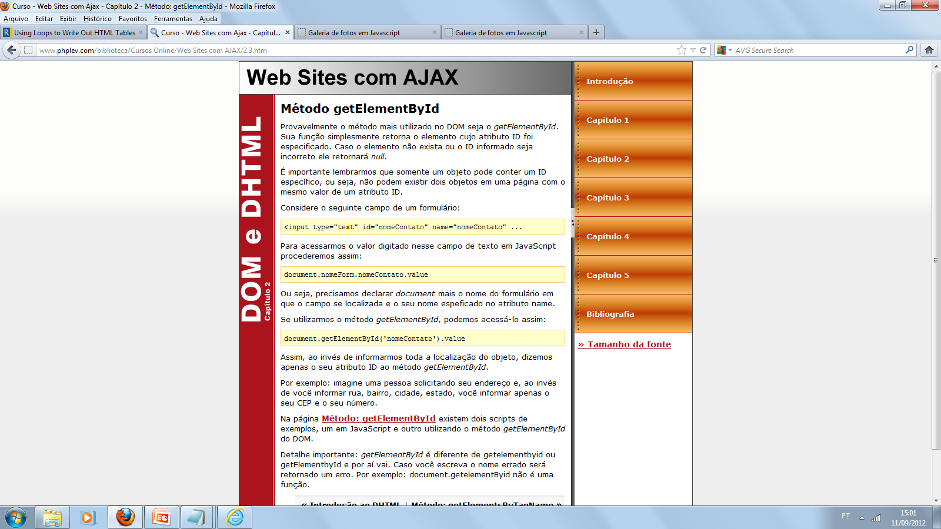

Slide 6
<td width="146">
<img src="01.jpg" width="100" height="90" onMouseOver="javascript: exibir('01');“ >
</td>
<td width="155">
<img src="02.jpg" width="100" height="90" onMouseOver="javascript: exibir('02');”>
</td>
<td width="139">
<img src="03.jpg" width="100" height="90" onMouseOver="javascript: exibir('03');”>
</td>
<td width="130">
<img src="04.jpg" width="100" height="90" onMouseOver="javascript: exibir('04');”>
</td>
<td width="114">
<img src="05.jpg" width="100" height="90" onmouseover="javascript: exibir('05');”>
</td>

Slide 7
<head>
<style>
img {
-moz-border-radius: 8px; /* Para Firefox */
-webkit-border-radius: 8px; /*Para Safari e Chrome */
border-radius: 8px; /* Para Opera 10.5+*/
background: black;
padding: 16px;
border: 1px solid yellow;
cursor:pointer;
}
</style>
<title>Galeria de fotos em Javascript</title>

